Slide 1
TECHNOLOGY DRIVERS FOR TODAY’S INFORMATION SYSTEMS

Slide 2
Technology Drivers
Networks and the Internet
Mobile and Wireless Technologies
Enterprise Applications

Slide 3
Networks and the Internet
Computer Network is a global system of interconnected several computers and devices through guided and unguided media to share data and available resources.
A computer in a network is able to share hardware, application software, peripherals devices, processing powers etc.
Networks include mainframe time-sharing systems, network servers, and a variety of desktop, laptop, and handheld client computers.
Internet is a global system of interconnected computers through guided or unguided media that uses the standard protocol suite (TCP/IP) to serve billions of users world wide.
Internet is also known as net.
The most pervasive networking technologies are based on the Internet.
XHTML and XML
Scripting languages
Web-specific programming languages
Intranets
Extranets
Portals
Web services
Notes:
Teaching Notes
The text quotes Scott McNealy of Sun Computer saying, “The network has become the computer.” Invite students to agree or disagree with that statement.
Could that statement be taken further to say that the Internet has become the computer?

Slide 4

Mobile and Wireless Technologies
Some mobile and wireless technologies
PDAs
Smart phones
Bluetooth
Wireless networking
Impact on information systems
Wireless connectivity must be assumed
Limitations of mobile devices and screen sizes must be accommodated
Notes:
Teaching Notes
Some students may be familiar with web surfing through mobile devices. Ask for their experiences.

Slide 5
Enterprise Applications
Virtually all organizations require a core set of enterprise applications
Financial management, human resources, sales, etc.
Frequently purchased
Frequently need to have custom elements added
Systems Integration - the process of building a unified information system out of diverse components of purchases software, custom-built software, hardware, and networking.
Notes:
Conversion Notes
The 7th edition adds this definition for systems integration, recognizing its growing importance.

Slide 6
Enterprise Applications
Enterprise Resource Planning (ERP)
Supply Chain Management (SCM)
Customer Relationship Management (CRM)
Enterprise Application Integration (EAI)

Slide 7
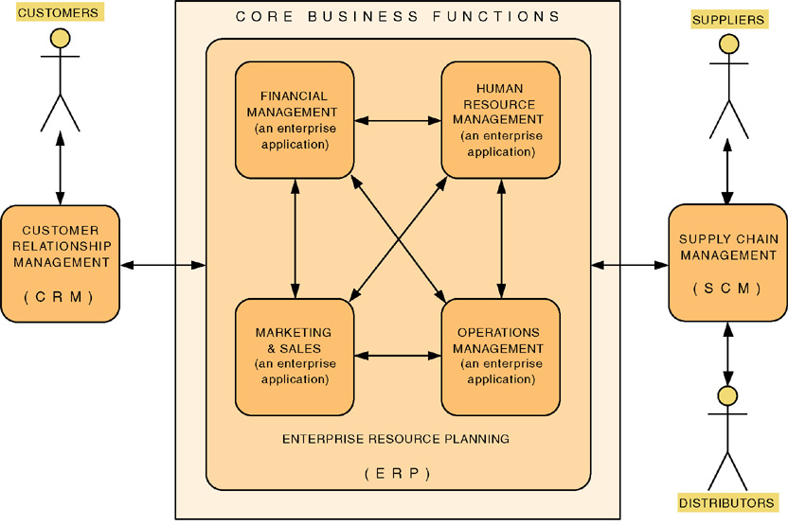
Enterprise Applications
Notes:
Teaching Notes
The trend is for these core enterprise applications to be purchased.
These purchased applications are never sufficient to meet all the information needs of the organization. Thus systems analysts and other developers are asked to develop value-added applications to meet additional needs.

Slide 8
Enterprise Applications - ERP
Enterprise Resource Planning (ERP) – a software application that fully integrates information systems that span most or all of the basic, core business functions.
An ERP solution is built around a common database shared by common business functions.
ERP redirects effort to activities such as customization, business process redesign and alignment, and system implementation.
Representative ERP vendors:
SSA (Social Security Administration)
Oracle/Peoplesoft
SAP AG (Structural Adjustment Program)
Notes:
Teaching Notes
ERP is dramatically changing the role of the modern systems analyst. Instead of spending effort on requirements planning and systems design, ERP redirects effort to activities such as customization, business process redesign and alignment, and system implementation.
Systems analysts who work on ERP projects are almost always called systems integrators.

Slide 9
Enterprise Applications - SCM
Supply Chain Management (SCM) – a software application that optimizes business processes for raw material procurement through finished product distribution by directly integrating the logistical information systems of organizations with those of their suppliers and distributors.
Representative SCM vendors:
SAP (Structural Adjustment Program)
SCT (Smart Choice Technology)
Notes:
No additional notes

Slide 10
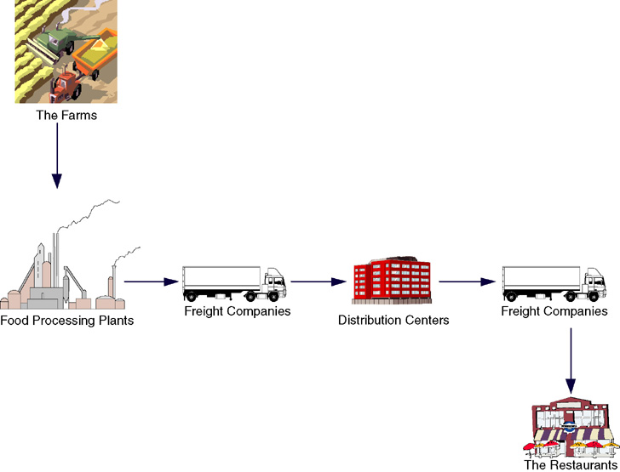
Supply Chain
Notes:
No additional notes.

Slide 11
Enterprise Applications - CRM
Customer Relationship Management (CRM) – a software application that provides customers with access to a business’s processes from initial inquiry through post sale service and support.
Representative CRM vendors:
SAP
BroadVision
Kana
Amdocs
Oracle/Peoplesoft
Siebel
Notes:
No additional notes

Slide 12
Enterprise Applications - EAI
Enterprise Application Integration (EAI) – the process and technologies used to link applications to support the flow of data and information between those applications.
Middleware – software (usually purchased) used to translate and route data between different applications.
Representative EAI vendors:
IBM (MQSeries)
Mercator Software
TIBCO Software
Notes:
No additional notes

Slide 13
System Development Process

Slide 14
System Development Process
System development process – a set of activities, methods, best practices, deliverables, and automated tools that stakeholders use to develop and maintain information systems and software.
A general problem-solving approach
Identify the problem.
Analyze and understand the problem.
Identify solution requirements or expectations.
Identify alternative solutions and choose the “best” course of action.
Design the chosen solution.
Implement the chosen solution.
Evaluate the results. If the problem is not solved, return to step 1 or 2 as appropriate.
Notes:
Teaching Notes
This is not an actual system development life cycle or methodology but simply general problem-solving steps.

Slide 15
A Simple System Development Process
Our Simplified System Development Process | General Problem-Solving Steps
System initiation | Identify the problem.
System analysis | Analyze and understand the problem. Identify solution requirements or expectations.
System design | Identify alternative solutions and choose the “best” course of action. Design the chosen solution.
System implementation | Implement the chosen solution. Evaluate the results. If the problem is not solved, return to step 1 or 2 as appropriate.
Notes:
Teaching Notes
This relates the problem-solving steps to the classic SDLC phases. Neither of these, though, are a methodology (as will be discussed in chapter 3).

Slide 16
Teaching Notes
ERP is dramatically changing the role of the modern systems analyst. Instead of spending effort on requirements planning and systems design, ERP redirects effort to activities such as customization, business process redesign and alignment, and system implementation.
Systems analysts who work on ERP projects are almost always called systems integrators.

